Slide 1
Designing an LTE Baseband MPSoC With a Novel Multi-Core HW/SW Platform Concept
Gerhard Fettweis, and
Emil Matus, Torsten Limberg, Markus Winter, Reimund Klemm, Marcel Bimberg, Marcos Tavares, Steffen Kunze
Vodafone Chair – TU Dresden
Talk at MPSoC 2009 in Savannah, GA
Notes:
Design Goals

Slide 2
SDR & Multimedia - Platform Requirements
Flexibility
Different types of processors for different applications (GPPs, domain specific, ASIPs, ASICs)
Modularity – build up system from established modules and specific components if necessary
Programmability
Programmability in accepted language like C
Real-Time capability
Efficient integration of accelerator tasks in control code
Programs should be binary compatible on similar architectures
Scalability
Efficient interconnection of system components

Slide 3
Terminology
Task
Atomic execution unit typically for algorithm kernels
Executed on a processing Element
May have varying, but must have maximum execution time
Tasks consume and produce chunks of data
(Real-Time) Thread
Execution unit consisting of control code and task instances
Executed on control processor
Real-Time Threads have deadline
Tasks from different threads have no data dependencies
Threads may have synchronization points
Program
Collection of Threads making a complete application

Slide 4
The Task
CPU
Encapsulated task executions
Data/programm locality
Processing without interruption due to bus access
Efficient utilisation of deeply pipelined global RAMs
Task Start
DMA
Data Load
Global Memory
PE
Task Execution
Local Memory
DMA
Data Store
CPU
Task End

Slide 5
Programming Model – Problem Statement
Operating System
Program: application to be executed
Threads: concurrent paths of execution within the program
Tasks: computational kernels consuming and producing chunks of data
Tasks can have data dependencies
Tasks can be executed on different kinds of processing elements (PE)
In conventional systems, task synchronization produces huge scheduling overhead
Problem: How can efficient mapping of tasks and control code be realized?
Program
Thread
Thread
t1
t2
t1
t2
t3
t3
t4
t4
t5
t5
t6
t6
SoC
PE1
PE2
PE3
CP
PE4
PE5
PE6
PE7
PE8
PE9
Notes:
Software and Hardware Part of the system
PE is something like DSP, ASIP, ASIC
Problem – Tasks are usually not independent!
Usual way of mapping: Start Tasks, use Semaphores, Interrupts or other Sync mechanism
Motivation facts do not allow such technique

Slide 6
Programming Model – Solution
Operating System
Solution: “CoreManager” hardware unit which takes cares of:
Dependency checking
Local memory management of PEs
Data transfers from and to local memories
Task mapping to PEs
CP sends task descriptions to CoreManager
Communication makes use of standard NoC interface
➔ No synchronization interrupts
➔ OS scheduling eased
➔ Predictable results due to explicit use of local memories
Program
Thread
Thread
t1
t2
t1
t2
t3
t3
t4
t4
t5
t5
t6
t6
SoC
PE1
PE2
PE3
CoreManager
CP
PE4
PE5
PE6
PE7
PE8
PE9
Notes:
Local memories increase predicatbility since no caching needs to be taken into account.
Task Runtime is not deterministic for GPP PEs due to unknown cache state. But an upper runtime limit can be computed for the case of uninitialized cache.

Slide 7
Programming Model – C++ Implementation
Threads are represented by C++ classes
Tasks may be C-functions or static C++ class members
class MyThread_t:
public RtThread_t {
private:
void _Execute ( );
int _status;
};
void MyThread_t::_Execute ( ) {
int i1[20], i2, o[20];
if ( _status == 0 )
task(t1, IN(i1, 4), IN(&i2, 4),
OUT(o, 4));
else
task(t2, IN(i1, 20), OUT(o, 20));
...
#pragma TASK_BEGIN
#pragma TASK_NAME t1
void t1(void *i1, void *i2, void *o) {
(int)o = (int)i1 * (int)i2;
}
#pragma TASK_END
int main() {
MyThread_t threadInstance;
threadInstance.Start ( );
return 0;
}
Task Call
Thread Instance Execution
Task Declaration/
Implementation
Thread Implementation
Thread Declaration
Notes:
MyThread_t is derived from Thread base class
Task functions may contain inlined assembly code
Start function is declared in base class

Slide 8
Hierarchy of Processing
Control Processor
Multi Threading OS
Per Thread Control:
Task Main Execution
Task Scheduler
“Core Manager”
Multi-Task MMU
Main Memory Buffer Ctrl.
Granularity
PE Task Queue Mgmt.
Processing Elements
Task Handling
Task Execution

Slide 9
Task Scheduler: Task Run-Time Management
Task Decoding
Data Dependency Check
Task List
PE and DMA Allocation
Scheduling
Dynamic Memory Allocation
Memory deallocation
Task Execution
DMA Transfers / Tasks

Slide 10
System Schematic
.cpp
TaskTools
.lib
Software
.o
.o
.o
Processing
Element
Processing
Element
Processing
Element
CoreManager
DMA
Control
Processor
Control
Processor
Control
Processor
DMA
Processing
Element
Processing
Element
DMA
Processing
Element
Hardware
DMA
Processing
Element
Processing
Element
Processing
Element
Interconnection

Slide 11
Task Tools
Program and Threads, written in C++
Tasks written in C++, C or C with inline Assembly
.cpp
using
.lib
Optimized algorithm kernels, written in C++, C or C with inline assembly
Task Splitter
.cpp
.c(pp)
.c(pp)
.c(pp)
CP C++
Compiler
PE C(++)
Compiler
PE C(++)
Compiler
PE C(++)
Compiler
.o
.o
.o
.o
Linker
.exe

Slide 12
CoreManager
CoreManager
Dependency checking
PE Allocation
Memory Allocation
Transfer Scheduling
Execution Scheduling
Resource Deallocation
RT-Extension
Task Priorization
Task Replacement
Dynamic Iteration Count Reduction
NoC
Read
Data
Cleanup Channels
Write
Data
Memory Allocator
DMA Controllers
Dependency Checker
Resource Allocation
Load
Prog.
Task Description Unit
PE Control
In-Place Modification Handling
NoC
Processing Elements

Slide 13
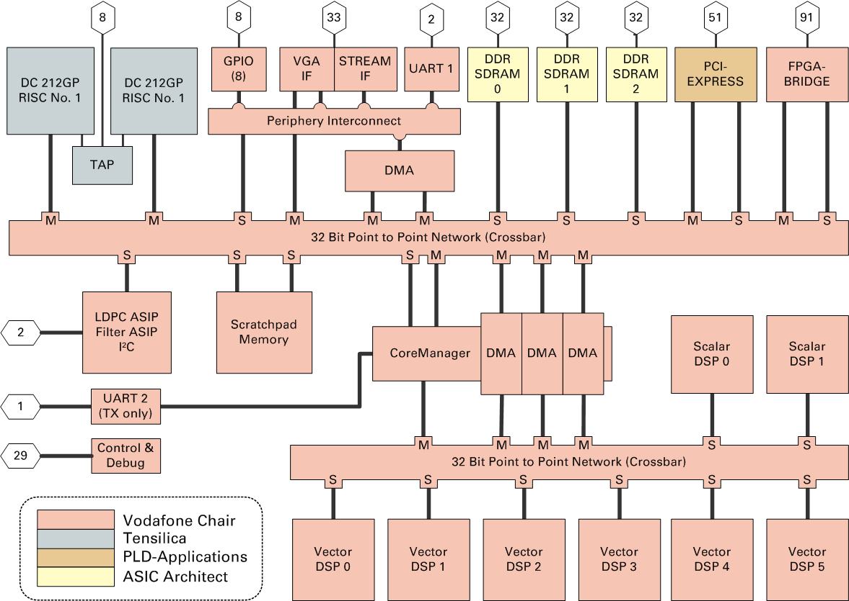
Tomahawk: MPSoC Architecture for LTE
LTE10 - 10MBit/s DL scenario
- 3x 5.47 GBit/s
- 10x “LTE10”
- 10x 5.47 GBit/s
- 30x “LTE10”
265 kB
1 MFLOP/MHz
3 MOPS/MHz
- 3x 5.47 GBit/s
- 10x “LTE10”
- 2x 5.47 GBit/s
- 7x “LTE10”
- 4 MMAC/MHz
- 0.8 GMAC/s
@200MHz
- 1x “LTE10”

Slide 14
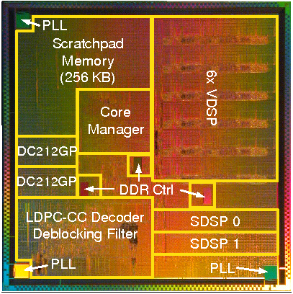
Tomahawk - Die Photo
- Taped out on May 7, 2007
- Returned on Aug 15,2007
& Jan 07, 2008
- UMC 130nm
8 metal layers
57 mil. transistors
40 GOPS @ 175MHz
12 Processors:
2x RISC
6x VDSP
2x SDSP
2x ASIP
On chip SRAM ~ 7.3 MBit
10 mm
10 mm
Notes:
Return Datum

Slide 15
Tomahawk: Area [mm²] and Power consumption [mW]
 |  | DC212GP | CoreManager | SDSP | 2x SDSP | VDSP | 6x VDSP | LDPC
AREA [mm2] | Logic | 1.10 | 2.60 | 0.25 | 0.50 | 0.65 | 3.90 | 2.10
 | Memory | 0.60 | 1.50 | 2.50 | 5.00 | 2.50 | 15.00 | 4.20
 | Post P&R | 2.50 | 5.90 | 3.30 | 6.60 | 3.80 | 22.80 | 7.50
Power [mW] | Simulated | 92.00 | 284.00* | 27.00 | 54.00 | 68.00 | 408.00 | 437.00
 | Measured | 30.00 | - | 26.00 | 52.00 | 84.00 | 504.00 | 354.00
* Without implemented clock gating; Factor ½ reduction of power consumption by using clock gating

Slide 16
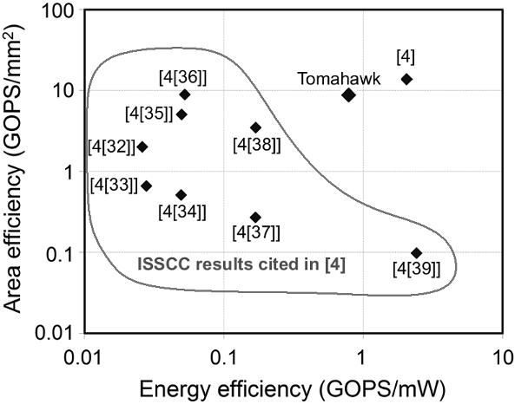
Area & Power Efficiency
MIMO SVD ASIC
Consumer RISC
Multimedia DSP
FFT Processor
RISC CPU with Media Processor
Communications DSP
CAM LSI
Video Stream Multi-Processor
Hearing Aid DSP
1
2
4
5
3
6
7
8
by 1
9
Source: Markovic et. al., Power and Area Minimization for Multidimensional Signal Processing, IEEE J. Solid-State
Circuits, vol. 42, no. 4, pp. 922-934, April 2007. Results scaled to 90 nm, operations are 12 bit add equivalents

Slide 17
Performance Scalability
LTE symbol duration ~70us → 14000 cycles @ 200MHz
Effective time/symbol budget for N PEs → N . 14000 cycles
Scalability depends on:
Task to scheduling time ratio,
Inter-Task dependency
Baseband signal processing:
Task execution time
~ 10² - 10⁴ cycles
SW scheduling
~ 10³ cycles/task
HW accelerated scheduling ~100 cycles/task
CoreManager scheduling:
60 cycles/task @100nJ
RISC (DC212GP) scheduling:
3000 cycles/task @ 500nJ
Measured for 0% or 50% task dependency

Slide 18
Conclusions
Scalable self-scheduled MPSoC HW/SW solution possible
For class of wireless communications applications
For multi-media
For …?
But not for everything
Tomahawk Test Chip
If scaled to 45nm CMOS: <200mW and <20mm² LTE baseband feasible!

