Slide 1
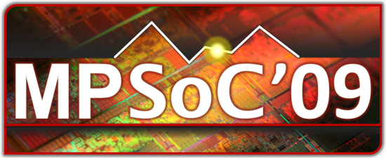
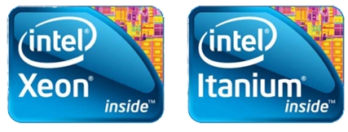
  Challenges of Multi-core Reliability
Olivier Franza
Copyright © Intel Corporation, 2009. All rights reserved. 3rd party marks and brands are the property of their respective owners. All products, dates, and figures are subject to change without notice.

Slide 2
Agenda
  “As technology scales, variability will continue to become worse. Random dopant fluctuations and sub-wavelength lithography will yield static variations, supply voltage and temperature variations will affect circuit performance and leakage power, soft-error rates will continue to rise, and transistor aging will become worse.”
Background
Causes
Solutions
Conclusion
  Shekhar Borkar, “Designing Reliable Systems from Unreliable Components: The Challenges of Transistor Variability and Degradation,” IEEE Micro, vol. 25, no. 6, pp. 10-16, Nov./Dec. 2005
Frequency and Leakage of Microprocessors in a Wafer
S. Borkar et al., “Parameter variations and impact on circuit and microarchitecture,” DAC, 2003

Slide 3
Background
Reliability definition
  The measurable capability of an object to perform its intended function in the required time under specified conditions Handbook of Reliability Engineering, Igor Ushakov
Importance of reliability
  Microprocessors’ quality and performance depends on their reliability
  Current technology stresses reliability in all areas: semiconductors, materials, packaging…
Influencing factors
  Fabrication process, mechanical assembly, electrical usage, environmental conditions
  Mechanical stress, radiation, excessive voltage, current density, temperature, magnetic and electrical fields
Negative effects
  Voltage, power, current, and/or temperature derating
  Metastability, logic timing margins, timing analysis
  Overdesign, yield degradation

Slide 4
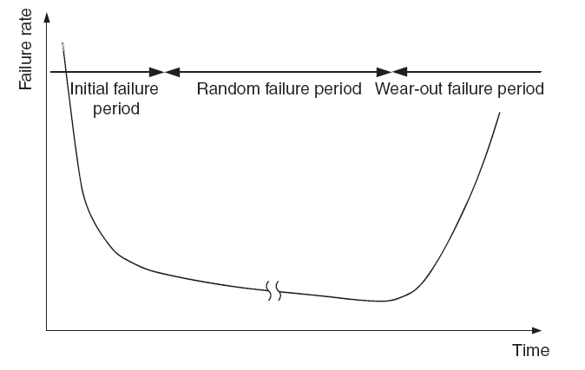
Causes
Failure rate/time to failure (TTF)
  Infant mortality
    Not screened in fabrication
    Causes
      Micro particles collecting on the wafer
      Material defects, impurity precipitation
      Photolithography defects , mask misalignment
      Damage during fabrication process, scratches
  Useful lifetime period
    Randomly occurring failures due to various causes – stress, temperature, radiation…
    Failure rate is almost constant and never decreases to zero
  Wear-out period
    Product reaching end of life cycle
    Rapid increase in failure frequency
    Caused by age-related wear and tear
      Electromigration, oxide film destruction, hot carrier damage, …

Slide 5
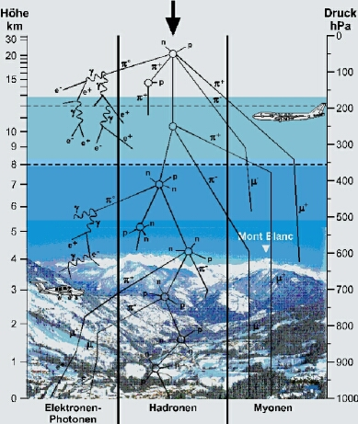
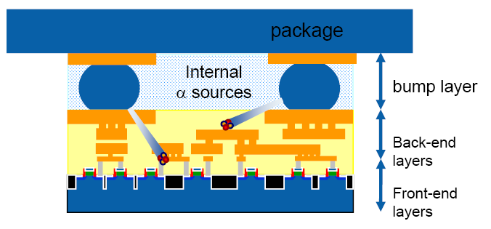
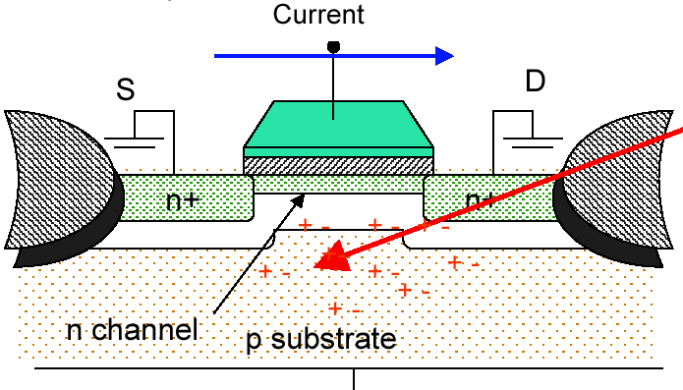
Causes
Radiation: terrestrial environment
  Neutrons
  Alpha particles
    Impurities in incoming materials for manufacturing
    α’s have a finite penetration depth, so externally generated α’s cannot penetrate package layers
    All SER events due to α-particles are generated by internal sources
N. Seifert, Intel
P. Hazucha, N. Seifert, Transient fault rate
Physikalisch-Technische Bundesanstalt

Slide 6
Causes
Radiation: single event effects (SEE) and soft errors (SE)…
  Electrical disturbance in a microelectronic circuit caused by the passage of a single ionizing particle through semiconductor material
  Classification
    SEE: Single Event Effect
    SER: Soft Error Rate (FIT)
    SEU: Single event upset
      SBU: Single bit upset
      MBU: Multiple bit upset
    SEFI: Single event functional interrupt
  Categorization of SEE's is also possible in terms of whether they are soft or hard errors
    Permanency level of damage made to the device
Radiation: SER Units
  Unit of SER is Failure in Time (FIT) – 1 FIT = 1 failure in 10⁹ device hours
  E.g.: 1Mbit SRAM, SER/bit ~ 1E-3 FIT => MTTF ~ 10⁹ /(1000 FIT*24*365) ~114 years
  But, with 10,000 components in system, => MTTF ~ 4 days!
    SEL: Single event latchup
    SET: Single event transient
    SEFI: Single event functional interrupt
    SEGR: Single event gate rupture
    SEB: Single event burnout
      SEGR/SEB are destructive hard errors

Slide 7
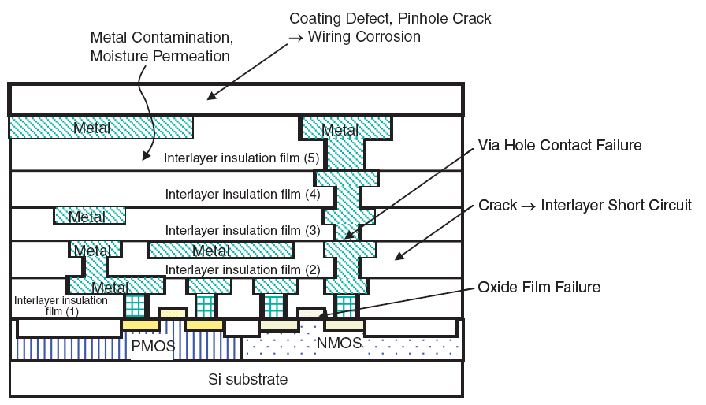
Causes
Process
  Technology scaling
  Feature size diminution
  Margin reduction
Borkar, Intel
Renesas, Reliability Handbook, 2008
Kauerauf, EDL, 2002

Slide 8
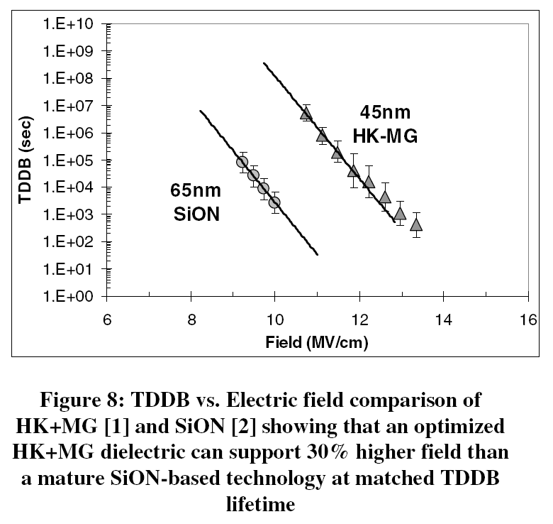
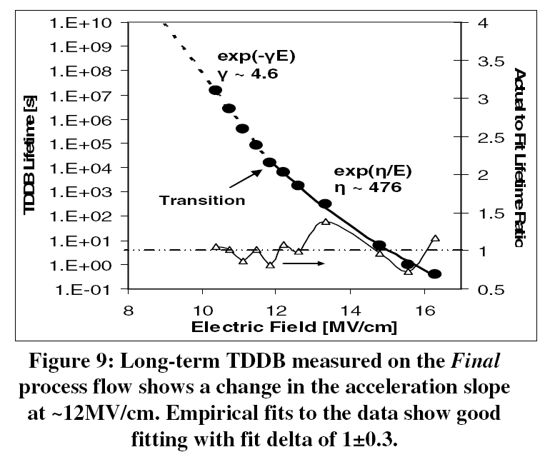
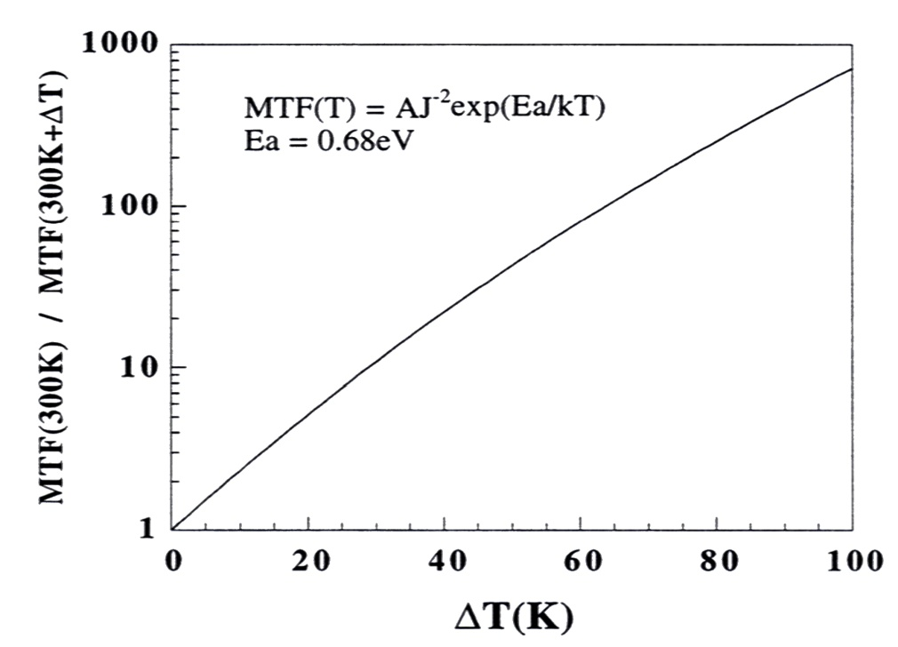
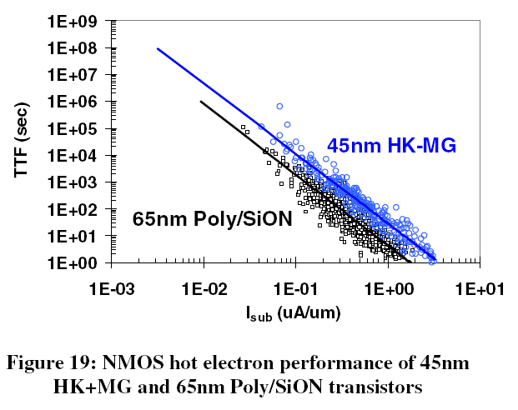
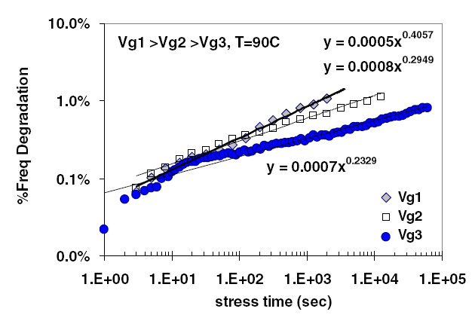
Causes
Process
  Technology scaling
Temperature/voltage
  Temperature cycling and localized hot spots are an issue
  Impact: stress, electromigration, hot carrier injection (HCI)
TDDB vs. electric field
Long-term electric field
Temperature effect on MTTF
NMOS hot electron performance
Ring oscillator stress
Steve Kang et al. Electrothermal analysis of VLSI Systems, Kluwer 2000
Intel Technology Journal, Volume 12, Issue 2, 2008

Slide 9
Solutions
Process – BIR (Built In Reliability)
  Methods and models developed during process development
  On-going reliability monitoring during fabrication
Architecture
  Error correction
  Redundancy – core-level, redundant multi-threading
  Models for reliability measurements (RAMP)
Design for reliability (DFR)/design for test (DFT)
  Process-specific model-derived design rules and specification
  Yield-aware variation-tolerant design, reliability-enhanced radiation-hardened devices
  Reliability-aware power management
  Built-in reliability test and repair – burn-in, JTAG, BIST, Dynamic Life Test (ALT)
  New variation-tolerant design methodologies
  Adaptive circuit techniques
  Statistical design
J. Srinivasan & al., “RAMP: A Model for Reliability Aware Microprocessor Design”

Slide 10

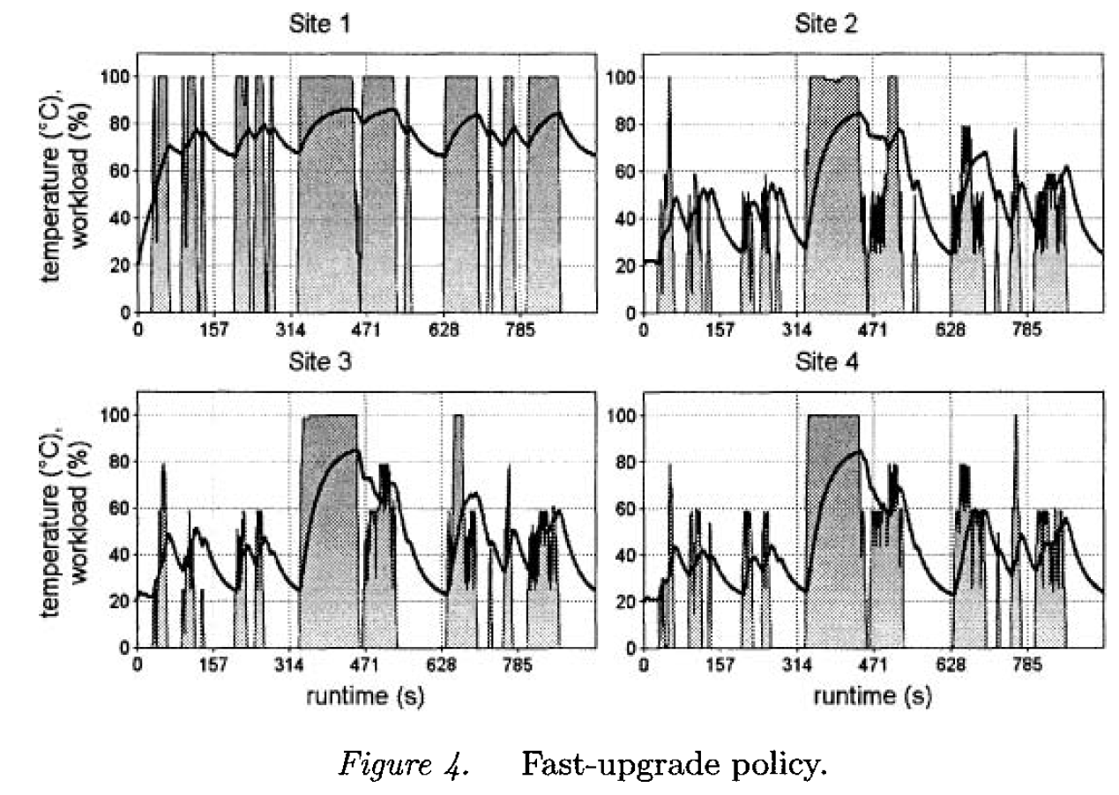
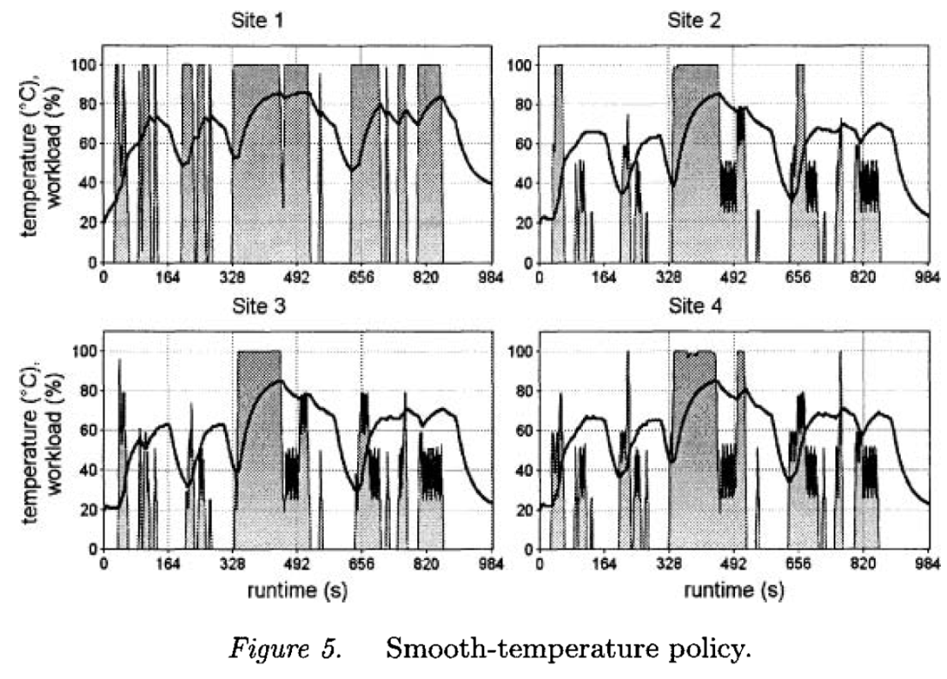
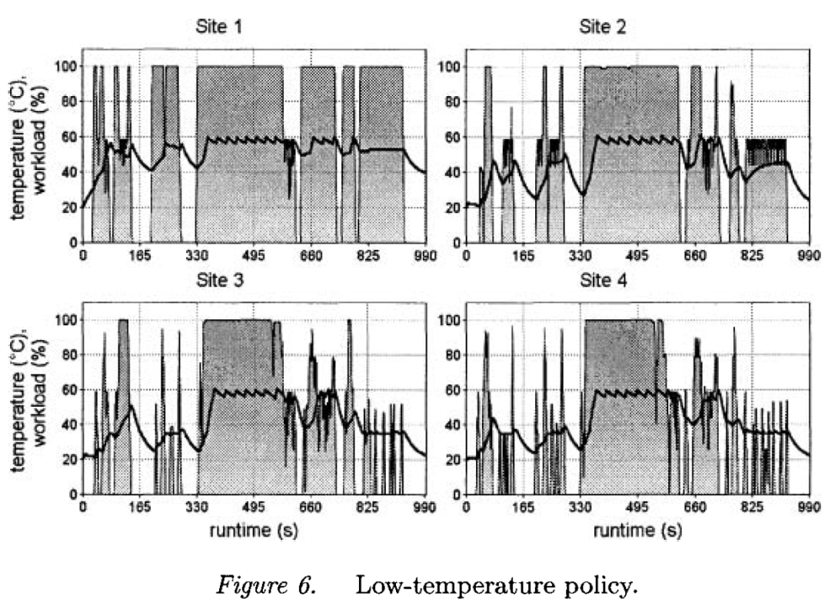
Solutions
Design for reliability (DFR)/design for test (DFT)
  Reliability-aware power management
    High temperature and temperature gradients decrease MTTF
    Power management traditionally favors fast changes between high and low activity states to optimize for power and performance, not reliability
    Reliability-aware power management can either target low max temperature but also “smooth temperature” policy to reduce thermal cycling
Arrhenius equation
Coffin-Manson relation
J. Haase & al., “Reliability-aware power management of multi-core microprocessors”

Slide 11
Solutions
Platform
  Auxiliary systems
    Redundancy and hot swap for all hardware components
    RAID storage
    Redundant DIMM sparing, memory mirroring with fault resilience
    Multiple fault-resilient IO paths
    Clusters failover with shared storage
    Fault resilient device drivers
  Platform integration
    High productivity and yield enhancement
    Systematic system-level yield management
Software
  Reliability prediction simulators (MULSIC, APET)
  Reliability-resilient programming
  Real-time chip performance compensation through real-time performance monitoring
H. Shin & al, “High Performance, High Reliability, Multi-Core Design Methodology”

Slide 12
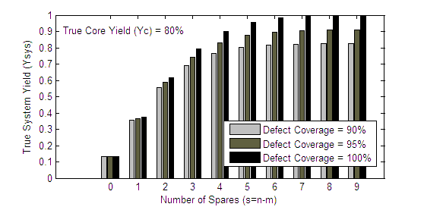
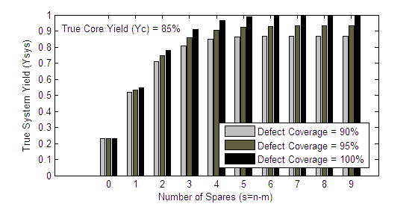
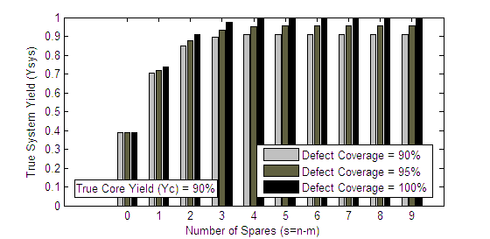
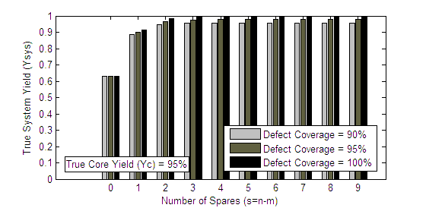
Solutions
Software
  Spare core analysis tool example
S. Shamshiri & al., “A Cost Analysis Framework for Multi-core Systems with Spares ”

Slide 13
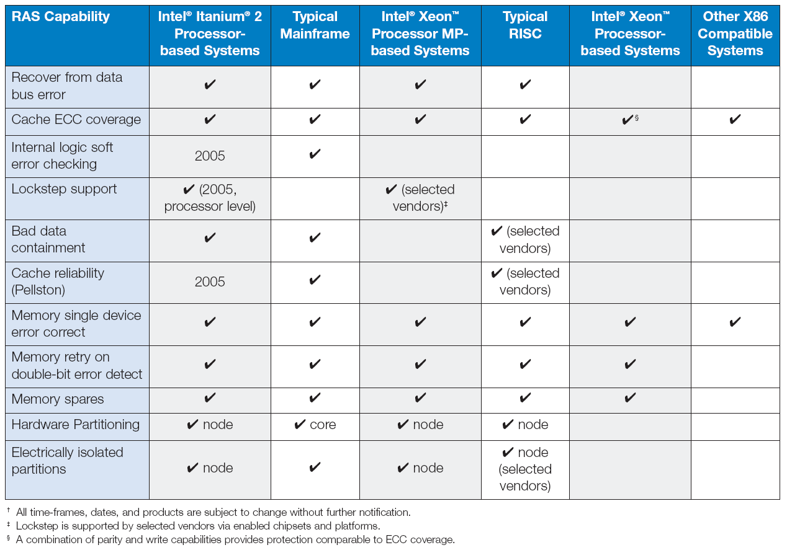
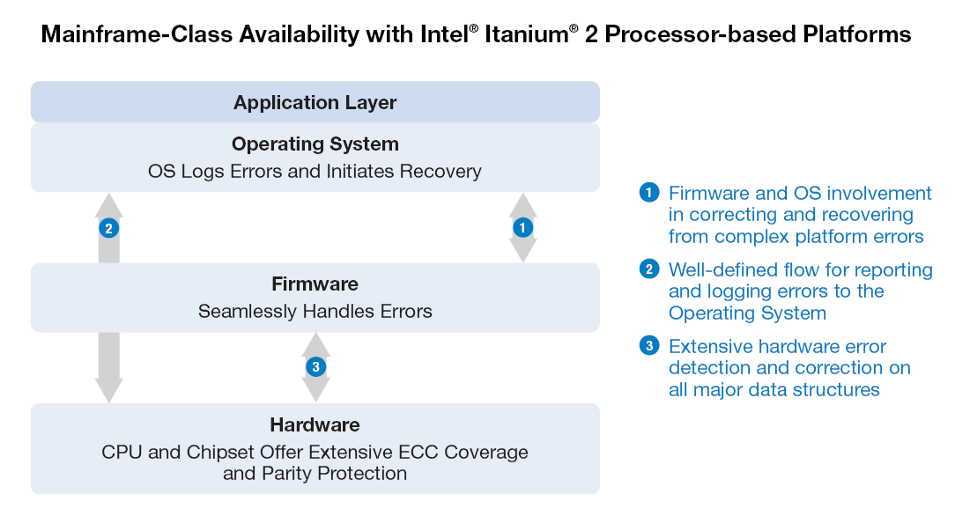
Solutions
Intel Active Management Technology
  Cross-platform capabilities for remote troubleshooting, recovery, and management
Intel, Reliability, “Availability, and Serviceability for the Always-on Enterprise”, 2005
Notes:
Machine Check Architecture (MCA): Provides integrated capabilities for logging, reporting, and handling errors.
Advanced Machine Check Architecture: Provides more advanced error-handling capabilities, with well-defined interfaces at the hardware, firmware, and OS levels.
Data Bus Error Checking and Repair:
System supports parity or Cyclic Redundancy Checking (CRC) on the data bus to detect errors. System supports Error Correction Code (ECC) and has the ability to retry the transaction. It can both detect and correct errors without downtime.
Cache ECC Coverage: Cache arrays are protected with ECC, so a soft error in a memory cell can be detected and corrected. Without this capability, the program would have to be terminated, and the whole system would most likely have to be reset.
Internal Logic Soft Error Checking: Parity checking is used on large arrays to detect soft errors and prevent applications from using corrupted data.
Lockstep Support: The same program can be run on two processors using the same data. Outputs are checked every clock cycle to assure data has not been corrupted.
Bad Data Containment: The system can tag a memory location that contains corrupted data (this is sometimes called “data poisoning”). The impact of the corrupted data is limited to the program using it at the time, and the bad data is eliminated when the program is finished or when it overwrites the location. This capability greatly reduces the need to reset a system if data is corrupted.
Cache Reliability (Pellston): Goes beyond ECC to further enhance the reliability of processor cache memory.
Memory Single Device Error Correction (SDEC): Enables the system to correct all memory errors if a single DRAM device fails.d
Memory Retry on Double-bit Error Detect: ECC can detect double-bit errors, but can only correct single-bit errors. In the event of a double-bit error, this enables the memory controller to retry the memory read, which may correct the error.
Memory Spares: Allows a failed memory device to be transparently replaced by a spare device. This improves performance, by eliminating the performance loss caused by ECC correction. It also improves reliability, since it can correct multiple soft errors in a memory device (ECC can only correct single errors).
Partitioning: A large computing system can be divided into multiple smaller partitions. The partitions have dedicated resources (which can often be shifted among them), can run different operating systems, and are isolated from software or resource faults in other partitions. Partitioning reduces overall cost of ownership, since the partitions are managed as a single system.
All Intel processor-based server platforms support logical partitioning using 3rd party software virtualization solutions (see Intel® Virtualization Technology, above). Hardware partitioning is supported by several platform vendors.
Electrically isolated partitions: Electrical isolation prevents hardware faults in one partition from affecting another. This enables multiple applications to be run on a single system, while maintaining a level of isolation comparable to running them on physically separate systems. It is also necessary to allow resources (such as a new processor board or memory board) to be added to a partition while other partitions continue running.

Slide 14
Conclusion
Summary
Source/Metric | Delay | Power | Reliability
Supply Voltage | Device speed either too slow or too fast | Dynamic power, Leakage, Static | Hot Carrier, SRAM Vmin
Temperature | Device speed, Interconnect Resistance | Leakage | Oxide breakdown, metal self-heating, PMOS Bias Temp
Process - Materials and Doping, lithography, oxide thickness, metal polish, etch, … | Device Leff, Weff, Ron, C parasitics, threshold voltage, wire R, oxide thickness | Dynamic power, leakage, static power | Writability failure, wearout, electromigration, …
Particle Hit - Type: Alpha, Neutron - Charge, Location, Time | Charge injection either speeds up or slows down critical transitions | not significant | Bit-flip, delay fault
Wear-out (e.g. NBTI) | Increased due to increased Vt | Leakage reduced due to increased Vt | Oxide breakdown, Delay fault
Control/Data | Rise/fall variation, coupling, | Activity factor, state dependent leakage | Logic masking, Architectural masking
Burleson, 2007

Slide 15

Conclusion
Reliability can’t be ignored
  Reliability decreases with shrinking technologies and rising transistor count
  Multicore SoC designs worsen the trend
  Methods have been used already to improve reliability
  “Blanket” redundancy is one of them but it is costly
  System reliability requires software contribution
Opportunities exist
  Multi-core solutions just beginning
  Metrics in place to evaluate impact
Acknowledgments: N. Seifert, B. Bowhill

