Slide 1
Hybrid Prototyping of MPSoCs
Samar Abdi
Electrical and Computer Engineering
Concordia University
Montreal, Canada
samar@ece.concordia.ca
http://www.ece.concordia.ca/~samar

Slide 2
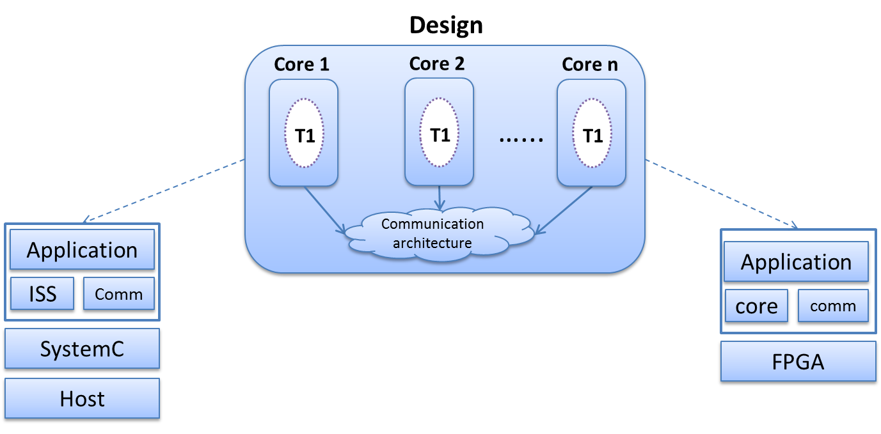
Virtual vs. FPGA Prototyping
Virtual
Prototyping
FPGA
Prototyping
Can we get the best of both worlds?
Ease of debug
Flexibility
Scalability
Speed
Accuracy
Observations
Only a few unique SW processors
Heterogeniety of clock freq./memory org.
Ease of debug
Flexibility
Scalability
Speed
Accuracy

Slide 3
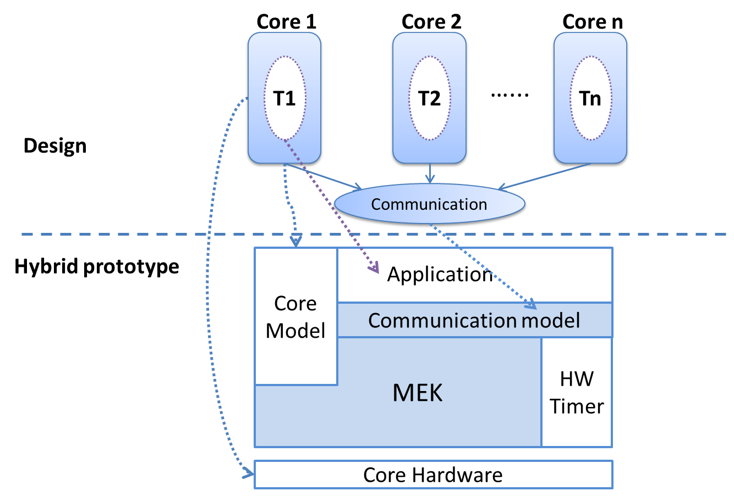
Hybrid Prototyping System
Ease of debug
Flexibility
Scalability
Speed
Accuracy
Only one core instantiated in FPGA
Multicore Emulation Kernel (MEK) executes on physical core
MEK provides services of a simulation scheduler
Application task code executed directly on the target core
Notes:
Hybrid Prototyping is a novel modeling technique for multicore embedded systems. The main idea is to simulate a design with multiple cores by creating an emulation kernel, called MEK, in software on top of a single physical instance of the core.
Unlike discrete event simulation in software, hybrid prototyping, advances simulation time as the task executes on the core, without the need for an explicit wait-for-time call. It uses a hardware timer to keep track of computation time during task execution. At communication boundaries, the emulation kernel updates the logical simulation time for a task and switches context to a different core, whose task is ready to run.
A communication model, particularly the inter-task synchronization, can be implemented on top of simulation primitives provided by the emulation kernel. Therefore, communication can be modeled at different abstraction levels, but the computation is executed as-is on the target core.

Slide 4
Multi-core Emulation Kernel
MEK supports discrete event simulation [DATE 2013]
Blocking waits and non-blocking notifies
Logical timestamps associated with each task
Events keep track of notification and wait times
Complex communication models built on top of discrete events
Time management
Physical time advanced by hardware time when app. tasks execute
Logical time advanced only inside MEK primitives
Task (core) state management
Task (core) context switched when a running task is blocked
Round-Robin scheduling policy used by MEK

Slide 5
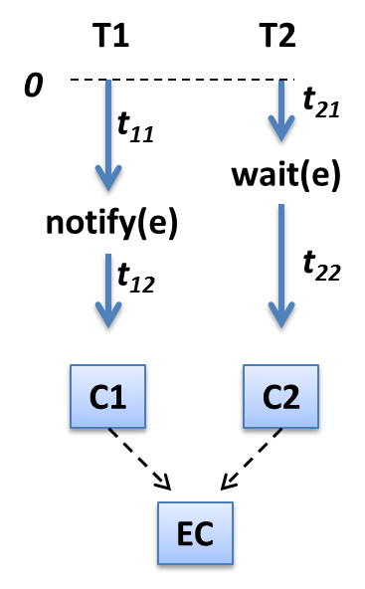
Simulation on Hybrid Prototype
T1
notify
CS
T2
wait
t₁₁
t₁₂
t₂₁
t₂₂
Emulation of tasks on two different cores
Case 1: MEK runs T1 first

Slide 6
Simulation on Hybrid Prototype
T1
notify
CS
T2
wait
CS
t₂₁
t₁₁
t₁₂
t₂₂
Emulation of tasks on two different cores
Case 2: MEK runs T2 first

Slide 7
JPEG Case Study
JPEG application with 5 tasks (easily pipelined)
Microblaze-based MPSoC platforms with up to 5 cores
Connected with fast simplex links (FSL)
Operating at 60 MHz [3.04mW] or 125 MHz [6.28 mW]
On-chip block RAMs (BRAMs) used for program and data
Single Microblaze used for hybrid prototyping
Total 162 designs modeled
Differentiated by number of cores, frequency and mapping
JPEG Application
Read
64
DCT1
64
Quant.
64
Zigzag
64
Huff.
180 iterations
MPSoC Platform
Core1
(MB)
Core2
(MB)
Core3
(MB)
Core4
(MB)
Core5
(MB)

Slide 8
Results: Simulation Quality
Hybrid prototype enables fast, scalable and accurate simulation
~seconds compared to hours for cycle-accurate software simulation
scales linearly with number of cores
assuming inter-core communication scales accordingly
Accuracy depends on accuracy of communication timing model
<0.001% error for JPEG compared to FPGA prototype
Simulation time (ms)
# cores

Slide 9
Results: Design Space Exploration
Hybrid prototype enables extensive design space exploration
162 JPEG design alternatives evaluated in ~5 mins*
Full FPGA prototyping of all alternatives takes >5 hours*
Ideal designs
* Includes FPGA synthesis time only. Simulation time is negligible.
Execution time (ms)
Energy consumption (nJ)

Slide 10
Future Plans
Memory hierarchy
Model caches as peripherals [DSD 2013]
Swap cache context when core context changes
Dynamically scheduled tasks
Build RTOS model on top of MEK [ICCD 2012, ISQED 2013]
Posix-API to support unmodified applications
Hardware accelerators
Model using MEK primitives (similar to communication)
Implement on FPGA alongside emulation core
Asymmetric cores
Instantiate one emulation core for each core type
Maintain consistency of simulation time across cores
Looking for collaborations!!

